Slide 1
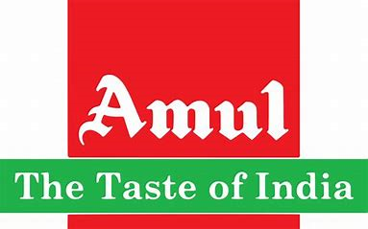
AMUL PRODUCTS
Comprehensive Digital
Marketing Project On
AMUL
Group: MPCS
Team leader: Anakapalli.Neelima(2102703201)
Team members:
Annu.Rohini(2102703202)
Bantupalli.Bhavani(2102703203)
Barri.Ranjitha(2102703204)
Basava.Madhuri(2102703205)

Slide 2

TOPICS
INTRODUCTION
BRANDING”THE TASTE OF INDIA”
UMBRELLA BRANDING OF AMUL
ADVERSTISING STRATEGY AND SUPPLY CHAIN MANAGEMENT OF AMUL
MARKING MIX OF AMUL
DIGITAL AND CONTENT MARKETING OF AMUL
MARKETING ELEMENTS OF AMUL
SWOT ANAIYSIS OF AMUL
COVID-STRATEGIES OF AMUL
CONSLUSION

Slide 3

INTRODUCTION
Established in 1946 anand milk union limited (AMUL)is a cooperative brand managed by Gujarat cooperative milk marking federation.
Amul was founded by tribhuvandas Patel under the direction for sardar vallabhabhai patel.
Amul was founded as a result of revolution to help the poor farmer.
Amul is a 75+ year old brand which is still a market leader

Slide 4

BRANDING
Celebrating the rich and diverse culinary heritage of India, showcasing the country's regional flavors, ingredients, and cooking traditions.
Emphasizing the authenticity, quality, and purity of Indian cuisine, highlighting the use of traditional cooking methods and locally sourced ingredients.
Positioning Indian food as not just a meal but an immersive cultural and sensory experience, appealing to a wide range of tastes and preferences.

Slide 5
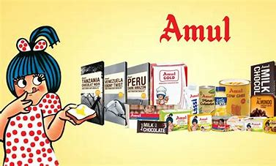
UMBRELLA BRANDING
Amul's umbrella branding strategy is a comprehensive approach that encompasses a wide variety of dairy products under a single, trusted brand. This strategy unifies products such as milk, butter, cheese, yogurt, and more, all under the recognizable Amul logo. It leverages the brand's reputation for quality and purity, creating a seamless and consistent consumer experience. By using the Amul name across their product range, they establish a sense of trust, reliability, and familiarity with consumers, making Amul a go-to choice for all their dairy needs. This approach also reinforces Amul's commitment to supporting local farmers and communities, emphasizing their cooperative and community-centric ethos. Overall, Amul's umbrella branding is a key driver of their enduring success and popularity in the Indian dairy market.

Slide 6
ADVERSTISING STRATEGY AND SUPPLY CHAIN MANAGEMENT OF AMUL
Amul's advertising strategy centers on the iconic Amul girl, known for her witty and timely commentary on various subjects. These advertisements create a relatable and humorous brand image, fostering strong consumer engagement and recognition.
In terms of supply chain management, Amul employs a cooperative model involving millions of dairy farmers. This cooperative structure ensures a consistent and fresh supply of high-quality dairy products while also empowering local communities and farmers. Their emphasis on quality control, efficient distribution, and sustainable practices further strengthens their supply chain, contributing to Amul's status as a trusted and leading dairy brand in India.

Slide 7
Goals
KPI’S
Dairy Farmer Welfare
Quality Dairy Products
Market Expansion
Research and Innovation
Environmental Sustainability
Rural Development
Financial Viability
Milk Procurement Volume
Revenue and Profitability
Market Share
Quality Standards
Customer Satisfaction
Dairy Product Sales
Supply Chain Efficiency
Environmental Impact

Slide 8
Competitor analysis
A prominent dairy cooperative in India, involves assessing other players in the dairy and related industries. Some key competitors and factors to consider includes:
Nestlé India
Mother dairy
Heritage foods
Vishaka dairy
Parag milk foods
Patanjali ayurved
Dodla paalu

Slide 9
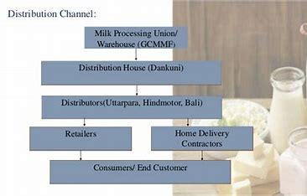

Slide 10
SEO (search engine optimization)
Website Structure and Technical SEO:
Check for proper site structure, including URL hierarchy and navigation.
On-Page SEO:
Ensure proper header tags (H1, H2, etc.) usage.
Technical SEO:
Ensure XML sitemaps are up to date.
Local SEO:
Optimize for local search if Amul has physical locations. Ensure consistent NAP (Name, Address, Phone Number) information.

Slide 11
MARKING MIX OF AMUL
Amul's marketing mix, also known as the 4Ps (Product, Price, Place, Promotion), can be summarized in six points:
Product: Amul offers a wide range of dairy products, including milk, butter, cheese, yogurt, ice cream, and more. They focus on quality, freshness, and purity, catering to various consumer preferences.
Price: Amul adopts a competitive pricing strategy, ensuring that their dairy products are affordable and accessible to a wide range of consumers, making them a popular choice in the market.
Place: Amul has an extensive distribution network that ensures their products are widely available across India, including rural and urban areas. They leverage a cooperative model, involving local farmers, to ensure a consistent supply.
Promotion: Amul's advertising strategy is notable for its use of the iconic Amul girl in witty and humorous advertisements. They also engage in various promotional campaigns and sponsorships, keeping their brand in the public eye.
People: Amul places importance on its employees and the dairy farmers who are part of its cooperative. Their commitment to supporting rural communities and farmers is integral to their brand image.
Process: Amul follows efficient and sustainable processes in dairy production and distribution, ensuring quality control and minimizing environmental impact. This approach aligns with their cooperative and community-centric ethos.
Overall, Amul's marketing mix is carefully designed to meet consumer demands for high-quality dairy products while maintaining affordability and a strong brand presence in the market.

Slide 12
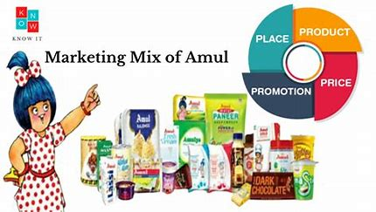

Slide 13
DIGITAL AND CONTENT MARKETING OF AMUL
Amul's digital marketing strategy leverages its strong online presence through a user-friendly website and active engagement on various social media platforms, including Facebook, Twitter, and Instagram. They create engaging and often humorous content, prominently featuring the Amul girl, which resonates with their audience. Amul conducts interactive campaigns, contests, and polls to encourage consumer participation and feedback. They also share informative content about dairy products, recipes, and health benefits to educate and engage their audience. User-generated content and customer testimonials are often shared, enhancing brand authenticity. Overall, Amul's digital and content marketing strategies prioritize brand visibility, consumer engagement, and a strong online community.

Slide 14
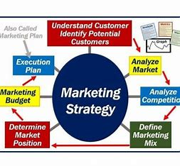

Slide 15
Marketing strategies
Milk Procurement Volume
Revenue and Profitability
Market Share
Quality Standard
Customer Satisfaction
Dairy Product Sales
Supply Chain Efficiency
Environmental Impact:
Employee Productivity and Satisfaction:
Market Expansion:
Innovation and Research:
Amul, known for its effective and innovative marketing strategies, has implemented several key approaches:
Ensure Dairy Farmer Welfare
Quality Dairy Products
Market expansion
Innovation and research
Sustainability
Customer satisfaction
Rural development
Financial viability

Slide 16
MARKETING ELEMENTS OF AMUL
Amul's marketing elements are a testament to its enduring success in the dairy industry. First and foremost, Amul boasts a comprehensive product portfolio, offering a wide range of dairy products that cater to diverse consumer preferences, from fresh milk to delectable ice creams. Their marketing strategy hinges on the iconic Amul girl, featured in witty and engaging advertisements that resonate with audiences across generations. Amul's robust distribution network ensures that their products are widely accessible throughout India. Furthermore, their competitive pricing strategy makes quality dairy products affordable to a broad spectrum of consumers. Central to their brand identity is their cooperative model, where local farmers play a pivotal role, emphasizing their commitment to community development and sustainability, and thereby enhancing brand authenticity and consumer trust

Slide 17
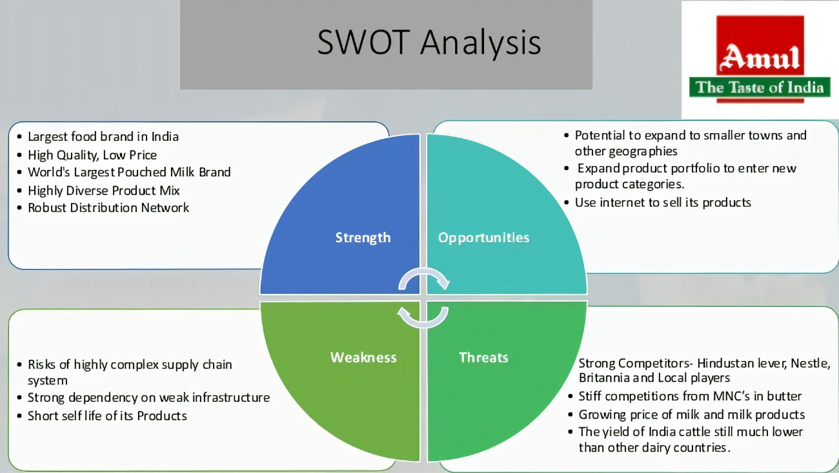

Slide 18
SWOT ANAIYSIS OF AMUL
Amul's SWOT analysis reveals a brand with significant strengths, potential weaknesses, promising opportunities, and notable threats.
Strengths lie in Amul's strong brand reputation for delivering high-quality dairy products and its extensive distribution network, ensuring accessibility across India. The cooperative model involving local farmers enhances sustainability and community support, reinforcing its authenticity.
However, potential weaknesses include limited diversification beyond dairy products, which may hinder growth prospects. Additionally, the cooperative structure might face challenges in terms of scalability and agility in a rapidly evolving market.
Amul has opportunities to expand its product line, especially in the health and organic food segments, and explore international markets, capitalizing on global demand for quality dairy and dairy-related products.
Yet, it also faces threats from intense competition, particularly from multinational dairy companies, changing consumer preferences, and market dynamics. Furthermore, fluctuations in milk production and regulatory compliance pose potential challenges to Amul's market position and growth trajectory.

Slide 20
COVID-STRATEGIES OF AMUL
During the COVID-19 pandemic, Amul implemented several strategies to adapt to the challenging circumstances. Firstly, they ensured the safety and health of their employees and dairy farmers by implementing strict hygiene protocols and providing necessary protective equipment. They also focused on maintaining an uninterrupted supply chain to meet the increased demand for essential dairy products. Amul actively communicated with consumers through digital channels to reassure them about product safety and availability. Additionally, they introduced new products like immunity-boosting milk variants to cater to changing consumer needs during the pandemic, demonstrating their adaptability and innovation.

Slide 21
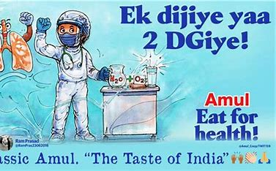


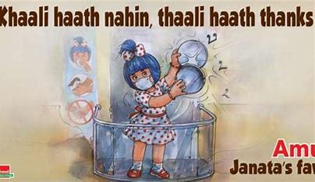

Slide 22
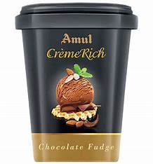
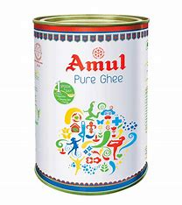
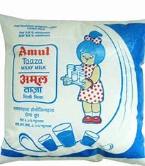
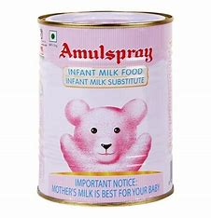
STP Analysis
Kids:

Slide 23
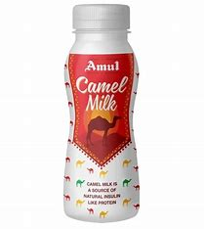
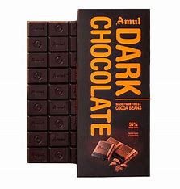
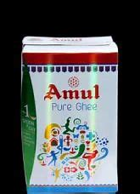
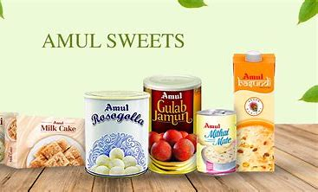
Youth:

Slide 24
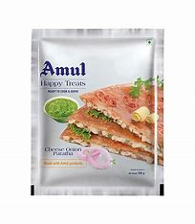
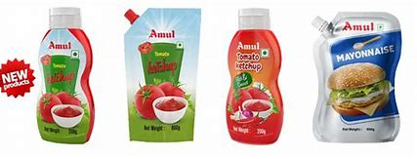
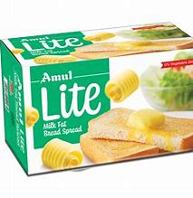
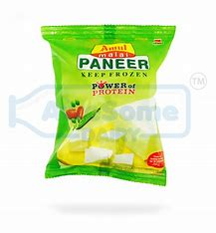
Women's:

Slide 25
Instagram profile 👇
https://instagram.com/amul_thetasteofindia_1946?igshid=OGQ5ZDc2ODk2ZA==
Check my story and highlights:
https://www.instagram.com/s/aGlnaGxpZ2h0OjE3OTU4NTUxMzA5NjU3NjY4?story_media_id=3211758255965373406_62494161440&igshid=OGQ5ZDc2ODk2ZA==
https://www.instagram.com/s/aGlnaGxpZ2h0OjE4MjA5NTQ5ODU3MjY2NDk1?story_media_id=3211753220007126729_62494161440&igshid=OGQ5ZDc2ODk2ZA==
https://www.instagram.com/s/aGlnaGxpZ2h0OjE4Mzk0MTEzNjYxMDQ5NzMx?story_media_id=3211738642082922667_62494161440&igshid=OGQ5ZDc2ODk2ZA==

Slide 26



Slide 27

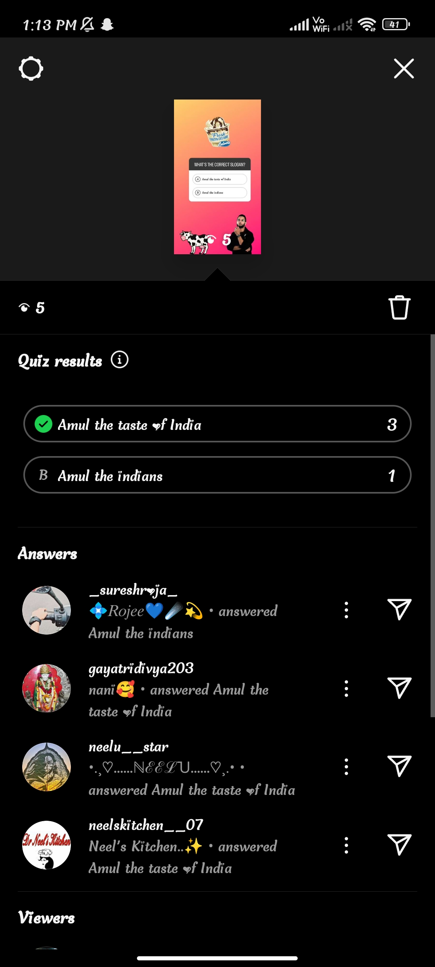

Slide 28
CONCLUSION
In conclusion, the Amul project has provided valuable insights into the branding, marketing, and strategies of this iconic dairy brand. Amul's success lies in its ability to maintain a strong brand image through creative advertising, its commitment to delivering high-quality dairy products, and its unique cooperative model that supports local farmers and communities.
Throughout this project, we have explored Amul's advertising strategy, supply chain management, digital marketing efforts, and the various marketing elements that have contributed to its enduring popularity in the Indian dairy industry. We have also discussed the SWOT analysis of Amul, highlighting its strengths, weaknesses, opportunities, and threats.
In the face of challenges like the COVID-19 pandemic, Amul has shown resilience and adaptability, continuing to serve consumers while prioritizing safety and innovation.

Slide 29


